Slide 1
Java Generics and Wrapper Classes

Slide 2
Wrapper Classes in JAVA
The wrapper class in Java provides the mechanism to convert primitive into object and object into primitive.
Since J2SE 5.0, autoboxing and unboxing feature convert primitives into objects and objects into primitives automatically. The automatic conversion of primitive into an object is known as autoboxing and vice-versa unboxing.

Slide 3
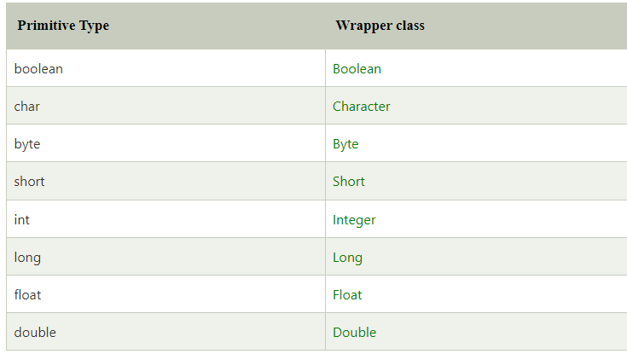
Wrapper Classes in JAVA

Slide 4
Autoboxing
The automatic conversion of primitive data type into its corresponding wrapper class is known as autoboxing, for example, byte to Byte, char to Character, int to Integer, long to Long, float to Float, boolean to Boolean, double to Double, and short to Short.
Since Java 5, we do not need to use the valueOf() method of wrapper classes to convert the primitive into objects.

Slide 5
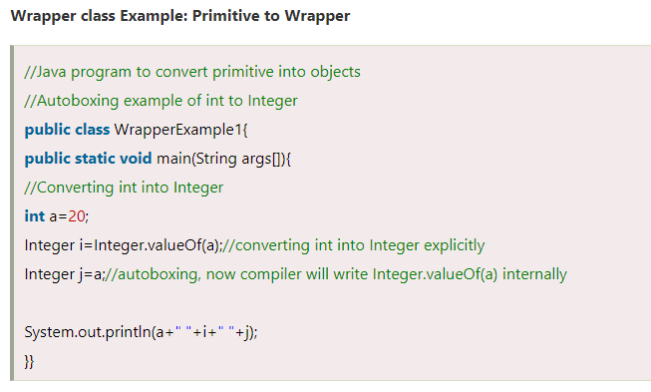

Slide 6
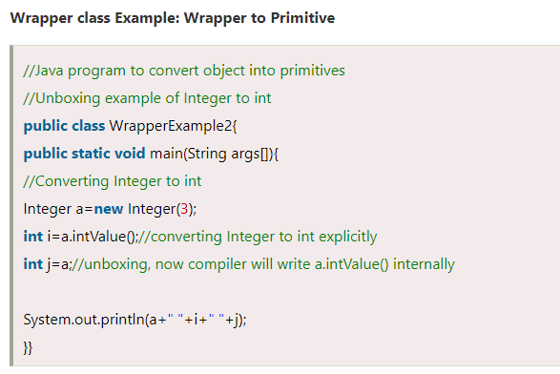
Unboxing
The automatic conversion of wrapper type into its corresponding primitive type is known as unboxing. It is the reverse process of autoboxing. Since Java 5, we do not need to use the intValue() method of wrapper classes to convert the wrapper type into primitives.

Slide 7
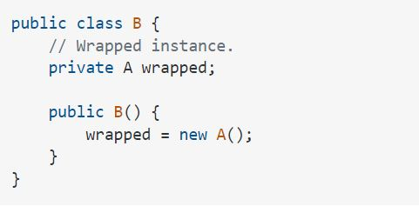
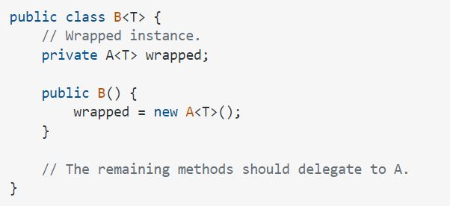
Example: Wrapper classes
Suppose you have a class A. You want to make a wrapper, B for it.
If A is generic, and you want B to be a generic wrapper, you just need to add the generic declaration.

Slide 8
Wrapper classes
As you know, using generics, we can write code without knowing the type of the objects the code operates on. It lets us create generic classes, constructors, and methods.
A generic class is defined using formal type parameters.
The following simple code declares a class Wrapper that takes one formal type parameter:
The parameter has been given a name T.
T is a type variable, which could be any reference type in Java, such as String, Integer, Double, etc.
The formal type parameter value is specified when the Wrapper class will be used.
public class Wrapper<T> { }

Slide 9
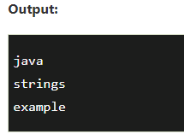
String Operations
public class StringExample{
public static void main(String args[]){
String s1="java";//creating string by Java string literal
char ch[]={'s','t','r','i','n','g','s'};
String s2=new String(ch);//converting char array to string
String s3=new String("example");//creating Java string by new keyword
System.out.println(s1);
System.out.println(s2);
System.out.println(s3);
}
}

Slide 10
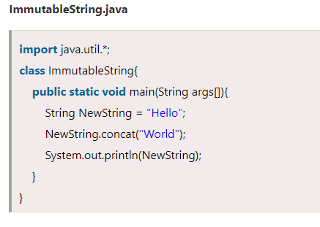
Why String is Immutable or Final in Java
In object-oriented programming, the immutable string or objects that cannot be modified once it is created. But we can only change the reference to the object.
We restrict to change the object itself. The String is immutable in Java because of the security, synchronization and concurrency, caching, and class loading.
The reason of making string final is to destroy the immutability and to not allow others to extend it.

Slide 11
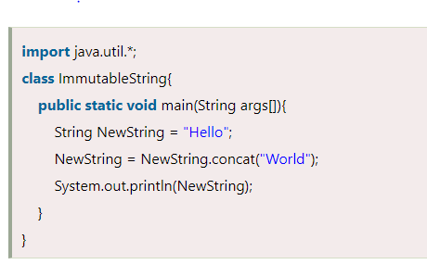
In the string constant pool, the Hello remains unchanged, and a new string object is created with HelloWorld.
It shows that the strings are immutable. The reference variable points to the Hello not to the HelloWorld.
If we want that it refers to the HelloWorld, we have to explicitly assign it to that variable. For example:

Slide 12

Java Generics
Java Generics is a powerful addition to the Java language because it makes the programmer's job easier and less error-prone. Generics enforce type correctness at compile time and, most importantly, enable implementing generic algorithms without causing any extra overhead to our applications.

Slide 13
Why do you need Generics?
Imagine a scenario where you would want to create a list in Java to store Integer. You might try to write the following:
List list = new LinkedList(); list.add(new Integer(1));
Integer i = list.iterator().next();
The compiler will complain about the last line! It does not know what data type is actually returned. The compiler will require an explicit casting as written below:
Integer i = (Integer) list.iterator.next();

Slide 14
Why do you need Generics?
Integer i = (Integer) list.iterator.next();
There is nothing that could guarantee that the return type of the list is an Integer. The defined list could hold any object. We only know that we are retrieving a list by inspecting the context. When looking at types, it can only guarantee that it is an Object & therefore
requires an explicit cast to ensure that the type is safe.
This cast can be annoying as well. We know that the data type in this list is an Integer. The cast is also cluttering our code. It can cause type-related runtime errors if a programmer makes a mistake with the explicit casting. It would be easier if programmers could express their intention to use specific types & the compiler ensured the correctness of such types.
This is the core idea behind Generics

Slide 15

Why do you need Generics?
List<Integer> list = new LinkedList<>();
In this example, by adding the diamond operator <> containing the type, we narrow the specialization of this list to only Integer type.
Simply said, we specify the type held inside the list. The compiler can enforce the type at compile time.
In small programs, this might seem like a minor thing. But in larger programs, this can add robustness & make the program much easier to read!

Slide 16
Type Parameters in Java Generics
The type parameters naming conventions are important to learn generics thoroughly. The common type parameters are as follows:
T – Type
E – Element
K – Key
N – Number
V – Value

Slide 17

Advantages of Generics
Programs that use Generics has got many benefits over non-generic code.
1
Code Reuse: We can write a method/class/interface once and use it for any type we want.
Type Safety: Generics make errors to appear compile time than at run time (It’s always better to know problems in your code at compile time rather than making your code fail at run time).
2

Slide 18
Properties of Generic Methods
We write generic methods with a single method declaration, and we can call them with arguments of different types. The compiler will ensure the correctness of whichever type we use. The following are some properties of generic methods:
Generic methods have a type parameter (the diamond operator enclosing the type) before the return type of the method declaration.
Type parameters can be bounded (we explain bounds later in this article).
Generic methods can have different type parameters separated by commas in the method signature.
Method body for a generic method is just like a normal method.

Slide 19
Bounded Generics
Remember that type parameters can be bounded. Bounded means “restricted,” and we can restrict the types that a method accepts.
For example, we can specify that a method accepts a type and all its subclasses (upper bound) or a type and all its super classes (lower bound).
public <T extends Number> List<T>fromArrayToList(T[] a) { ...
}
We use the keyword extends here to mean that the type T extends the upper bound in case of a class or implements an upper bound in case of an interface.

Slide 20

Multiple Bounds
<T extends Number & Comparable>
A type can also have multiple upper bounds. If one of the types that are extended by T is a class (e.g. Number), we have to put it first in the list of bounds. Otherwise, it will cause a compile-time error.

Slide 21

Wildcards with Generics
Wildcards are represented by the question mark (?) in Java, and we use them to refer to an unknown type. Wildcards are particularly useful with generics and can be used as a parameter type.
But first, there is an important note to consider. We know that Object is the supertype of all Java classes.
However, a collection of Object is not the supertype of any collection.
For example, a List<Object> is not the supertype of List<String>, and assigning a variable of type List<Object> to a variable of type List<String> will cause a compiler error. This is to prevent possible conflicts that can happen if we add heterogeneous types to the same collection.

Slide 22

Type Erasure
Generics were added to Java to ensure type safety. And to ensure that generics won't cause overhead at runtime, the compiler applies a process called type erasure on generics at compile time.
Type erasure removes all type parameters and replaces them with their bounds or with Object if the type parameter is unbounded. This way, the bytecode after compilation contains only normal classes, interfaces and methods, ensuring that no new types are produced. Proper casting is applied as well to the Object type at compile time.

Slide 23
Generics & Primitive Data Types
One restriction of generics in Java is that the type parameter cannot be a primitive type.
For example, the following doesn't compile:
List<int> list = new ArrayList<>();
list.add(17);
To understand why primitive data types don't work, let's remember that generics are a compile-time feature, meaning the type parameter is erased and all generic types are implemented as type Object.
Let's look at the add method of a list:
List<Integer> list = new ArrayList<>(); list.add(17);
The signature of the add method is:
boolean add (E e);
And will be compiled to
boolean add (Object e);
Therefore, type parameters must be convertible to Object.

Slide 24
Generics & Primitive Data Types
One restriction of generics in Java is that the type parameter cannot be a primitive type.
For example, the following doesn't compile:
List<int> list = new ArrayList<>();
list.add(17);
To understand why primitive data types don't work, let's remember that generics are a compile-time feature, meaning the type parameter is erased and all generic types are implemented as type Object.
Let's look at the add method of a list:
List<Integer> list = new ArrayList<>(); list.add(17);
The signature of the add method is:
boolean add (E e);
And will be compiled to
boolean add (Object e);
Therefore, type parameters must be convertible to Object.

Slide 25
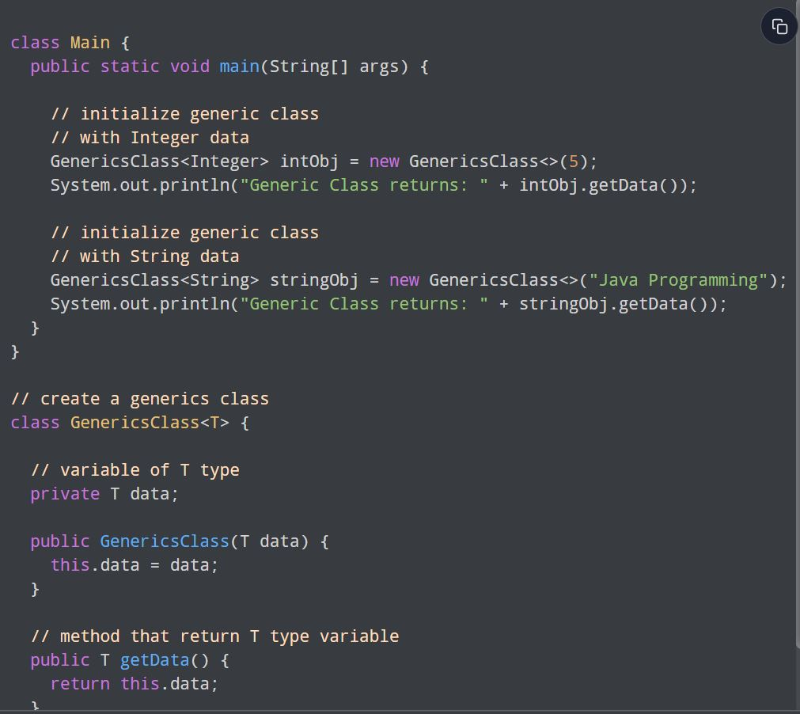
Example: Create a Generic Class

Slide 26
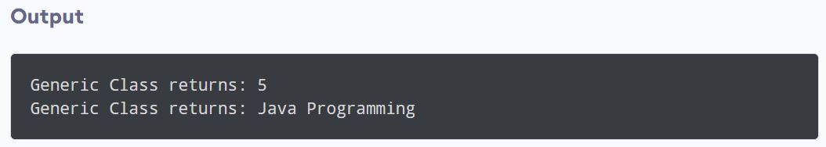
Example: Create a Generic Class
OUTPUT

Slide 27
Example: Create a Generic Class
Here, T used inside the angle bracket <> indicates the type parameter. Inside the Main class, we have created two objects of GenericsClass
intObj - Here, the type parameter T is replaced by Integer. Now, the GenericsClass works with integer data.
stringObj - Here, the type parameter T is replaced by String. Now, the GenericsClass works with string data.

Slide 28

“The capacity to learn is a gift; the ability to learn is a skill; the willingness to learn is a choice!”
------- Brian Herbert------

Slide 29
Thank You

